Slide 1
Twitter Sentiment Analysis on Bitcoin Data
Sabiha Barlaskar
05/17/2018

Slide 2
Problem
Determine the sentiment of the tweets (positive, negative or neutral) related to Bitcoins
Compare the trend of the sentiment with the trend of the bitcoin prices
Determine the locations from where the tweets have been tweeted the most

Slide 3
Data Retrieval
Tweepy (Python API)
Tags
Coindesk API
requests.get("https://api.coindesk.com/v1/bpi/historical/close.json?start=2018-01-01&end=2018-05-01").json()

Slide 4
Main strategy
Retrieved the tweets using Tweepy (42057 tweets)
Removed unwanted characters, punctuation marks
Removed stop words, duplicate and NaN rows
Removed tweets containing words ‘like’,’comment’,’follow’
Tokenized data into unigrams and bigrams
Converted the data into training and testing set
Tagged the data sets positive and negative labels (Manual + Vader)
Used MaxEnt and Naïve Bayes classifier to perform the sentiment analysis
Retrieved the bitcoin data and observed the trends

Slide 5
Main Strategy
Collected 42057 tweets using a software called Tags and Tweepy.
Converted the tweets into a data frame format
Dropped the duplicate tweets and columns containing NaN values
Cleaned the tweets to remove any character other than the English letters and numbers
Used Vader to assign a polarity score
analyzer = SentimentIntensityAnalyzer()
data['scores'] = [analyzer.polarity_scores(tweet)['compound'] for tweet in data.text]
Positive' if x>=0.05 else 'Negative' if x<=-0.05 else 'Neutral’
Manually analyzed Neutral tweets and relabeled it into Positive, Negative and Neutral (6287 Tweets)

Slide 6
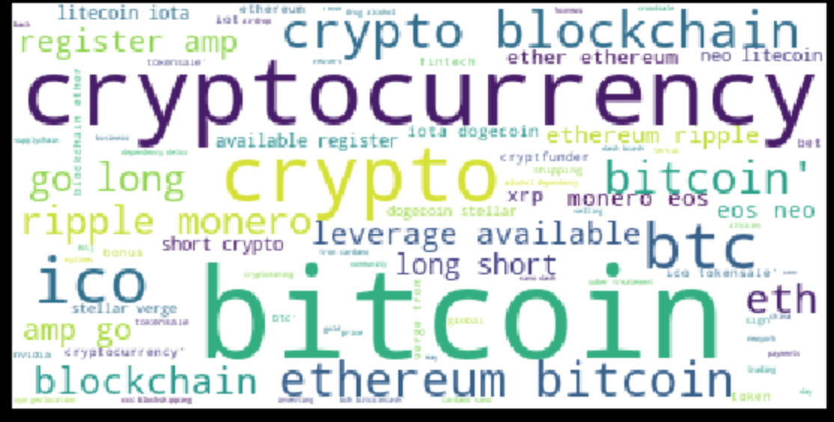
Main Strategy (continued…)
5. Removed the stop words from the Tweets using the NLTK toolkit
6. Filtered the tweets that contained words like:
‘Like’, ‘Follow’, ‘Comment’, ‘Free’
7. Retrieved the most frequently used words and formed a WordCloud

Slide 7
Main Strategy (MaxEnt classifier)
8. Divided the data into training and testing sets
9. Used Maximum Entropy classifier to train the tweets.
10. Converted the data into a format that Maximum Entropy understands:
([u’milestone', u’almost', u'', u’bitcoin', u’crypto', '], ‘pos’)
def list_to_dict(words_list):
return dict([(word, True) for word in words_list])
train_feats = [(list_to_dict(word_tokenize(i)), j) for i,j in zip(train_data,sentiment_train)]
test_feats = [(list_to_dict(word_tokenize(i)), j) for i,j in zip(test_data,sentiment_test)]
11. Predicted the label of the test data
12. Retrieved the accuracy and f1-scores

Slide 8
Main Strategy (MaxEnt classifier using Bigram approach)
Tagged the parts of speech of the words
Extracted the adjectives
adjectives = []
for i in pos_tag(word_tokenize(str(data))):
if 'JJ' in i:
if len(i[0])>3 and i[0] not in adjectives and i[0].isalpha():
adjectives.append(i[0])
else:
continue
return adjectives
15. Extracted those sentences which had these adjective words and constructed bigrams with it
16. Trained with Maximum Entropy classifier (To do)

Slide 9
Main Strategy (Naïve Bayes classifier)
1. Tokenized and converted data into bag of words
2. Created a frequency matrix using the bag of words
3. Trained the data using Multinomial Naïve Bayes classifier
4. Predicted the sentiment of the test data and observed the scores.

Slide 10
Comparison with Bitcoin Trend
Observe the bitcoin trend within a specific time interval
Divide the bitcoin and tweet data into specific time intervals of 15minutes, 30 minutes and 45 minutes
Calculate the rate of change of opinion within that period.
If the subsequent tweets are positive, score = +1
If positive, followed by negative, followed by positive, score = 0
If subsequent tweets are negative, score = -1
If for the historical price, the positive scores are high, then there is a probability of increase in price in the next 2 hours

Slide 11
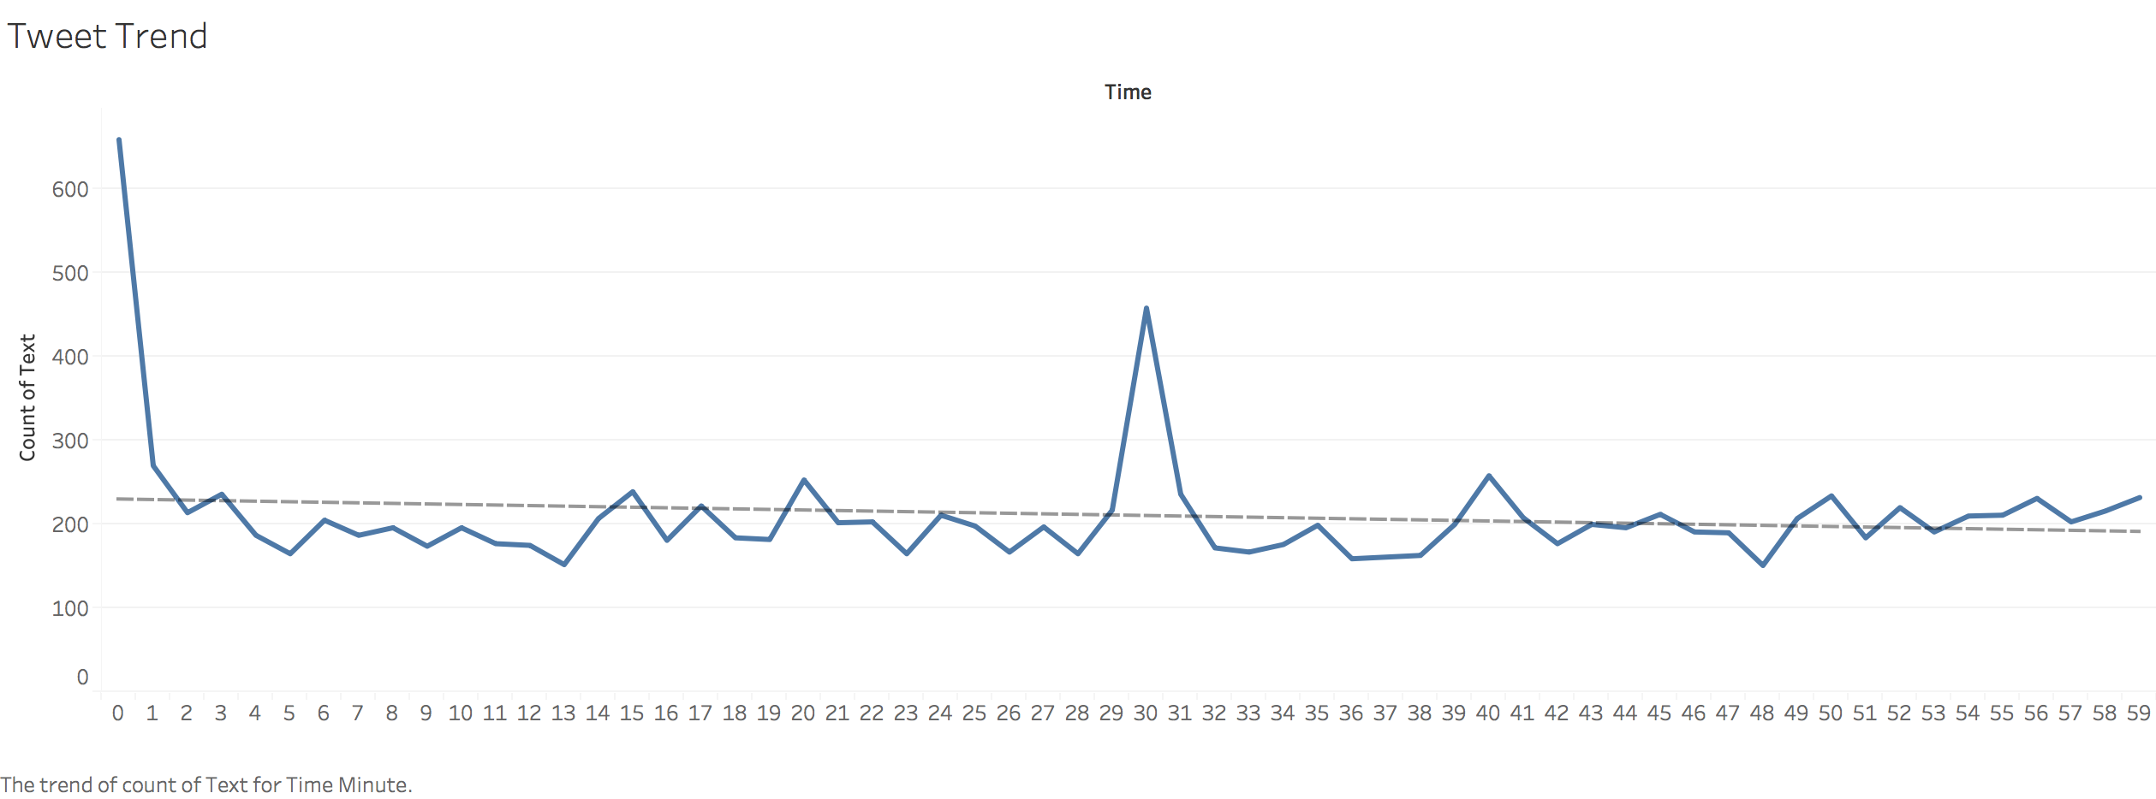
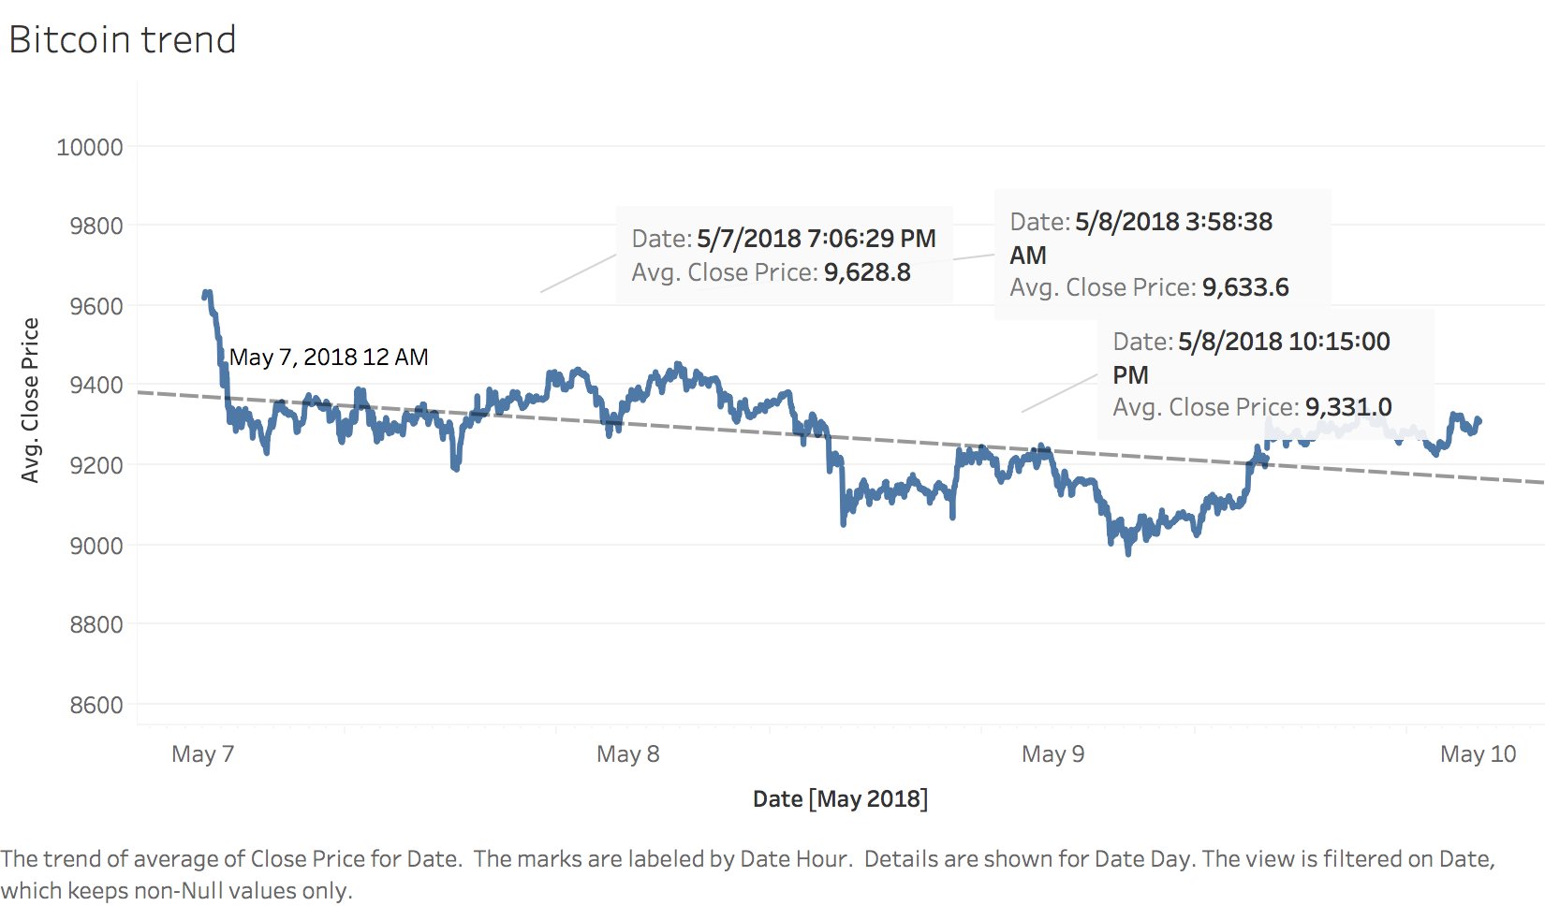
Comparison with Bitcoin Trend
Figure2: Trends of the tweet
Figure3: Trends of the bitcoin prices

Slide 12
Evaluation Strategy
Accuracy: The total number of correct predictions from all the predictions
Precision: The ratio between correctly predicted (positive) to all the predictions that were labeled correct (positive)
Recall: The ratio between correctly predicted(positive) and all the events
F1-score: Harmonic mean between precision and recall

Slide 13
Main Results
Algorithm | Naïve Bayes | MaxEntropy
F1 score | 0.689 | 0.83
Accuracy | 0.742 | 0.84
Precision | 0.682 | 0.837
Recall | 0.698 | 0.82
Notes:
'accuracy': 0.8208645054031588, 'model': <ConditionalExponentialClassifier: 3 labels, 23166 features>, 'negF_Score': 0.5990783410138248, 'negPrec': 0.7514450867052023, 'negRecall': 0.49808429118773945, 'posF_Score': 0.811480022509848, 'posPrec': 0.8073908174692049, 'posRecall': 0.8156108597285068

Slide 14
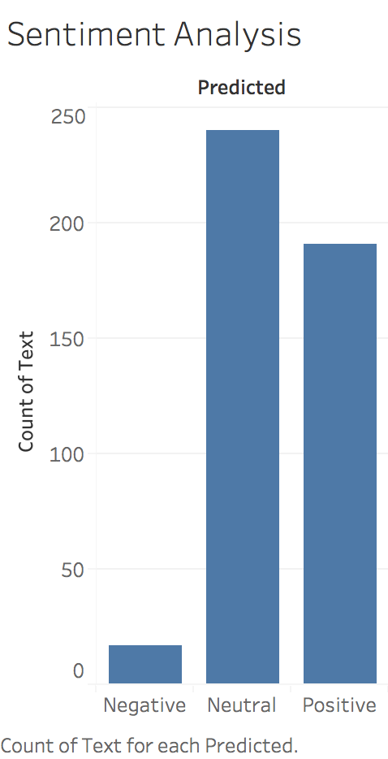
Main Results

Slide 15
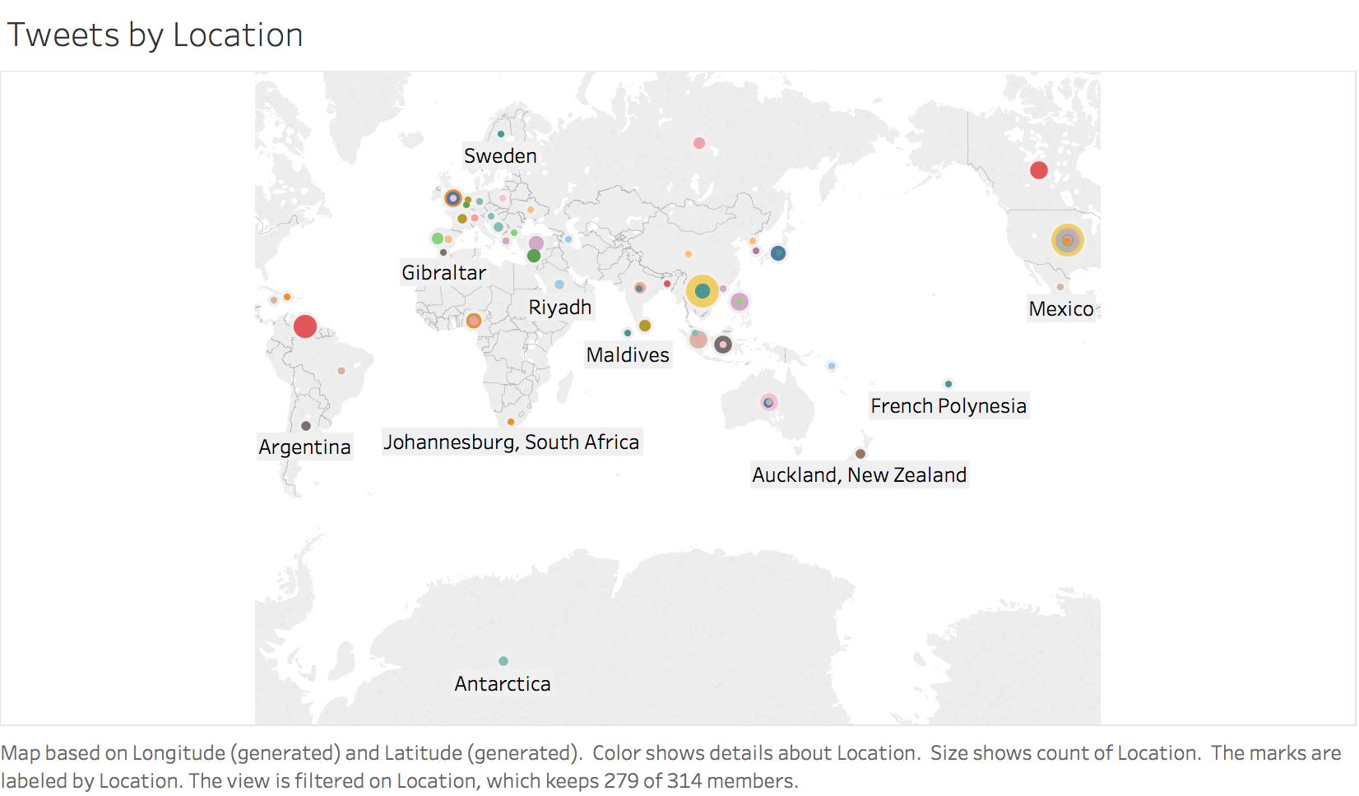
Main Results

Slide 16
Limitations of my approach
Manual Labeling of tweets
Not much data due to limited resources
Cannot determine the context of the tweet
Limited only to Bitcoin data
Limited only to the English language
No importance given to emoticons
Classic Machine learning approach, no use of deep learning

Slide 17
Future work
Understand the semantics and context of the tweet
Use unsupervised approach to find the sentiment instead of depending on manual labor
Feature selection and understand which words are more important by analyzing vast amount of varied data

Slide 18
References
1. Evita Stenqvist Jacob Lönnö, “Predicting Bitcoin price fluctuation with Twitter sentiment analysis”
2. Alec Go, Richa Bhayani, and Lei Huang. 2009. “Twitter sentiment classificationusing distant supervision”. CS224N Project, Stanford 1, 12 (2009).
3. Debjyoti Paul, Feifei Li, Murali Krishna Teja, Xin Yu, Richie Frost, University of Utah, “Compass: Spatio Temporal Sentiment Analysis of US Election”

